Slide 1
Introduction to Machine Learning Day 3
© 2025 Virginia Polytechnic Institute and State University. All rights reserved.

Slide 2
Supervised versus unsupervised learning
Some tangible measurement(s)
“The Black Box”
INPUTS
MACHINE LEARNING MODEL
OUTPUT(S)
Supervised Learning
In the context of domain knowledge
“The Black Box”
INPUTS
MACHINE LEARNING MODEL
PATTERNS,
RELATIONSHIPS, STRUCTURE
Unsupervised Learning
does it make sense?
Notes:
Supervised:
Output
Interested in predicting (continuous=regression, discrete category=classification)
Unsupervised: No output
Interested in revealing patterns or relationships

Slide 3
Supervised learning method selection is based on the response type
Is my response quantitative or qualitative?
Age
Height
Income
Stock Price
Tensile Strength
Quantitative
Qualitative
Blood Type
Default on Debt (y/n)
Cancer Stage
Brand Purchased
Species
Typically use regression method
Typically use classification method
Discrete: Nominal or Ordinal
Continuous Measures
What about the predictors?
For most methods, predictors can be
either quantitative or qualitative.

Slide 4
Two methods of estimation
Parametric
(Less Flexible, More Interpretable)
Non-parametric
(More Flexible, Less Interpretable)
Inference focused
Select a model which involves an assumption about the functional form of f. Train the model and estimate parameters.
Example:
f is linear in X: f(X) = β₀+β₁X₁ + β₂X₂ +…+ β_{p}X_{p}
Prediction focused
Does not make explicit assumptions about the functional form of f. Can fit wider range of possible shapes for f, but at that cost of needing a larger number of observations.
Example:
Splines
Tree-based methods

Slide 5
Introduction to Machine Learning Course Roadmap
What is the goal of the data analysis?
Predict an output |  |  |  |  |  | Reveal patterns or relationships |  | Make decisions using an autonomous agent
Supervised Learning (Output in the data set) |  |  |  |  |  | Unsupervised Learning (No output in the data set) |  | Reinforcement Learning* (Supervised & unsupervised)
Continuous or discrete output? |  |  |  |  |  | What is the subgoal? |  | Does a model exist?
Continuous |  |  | Discrete |  |  | Identify groups | Reduce dimensions | Model Based | Model Free
Simple linear regression Multiple linear regression Subset selection Ridge regression & LASSO PCR & PLS | Polynomial regression Step functions Splines Local regression General additive models | Decision tree Random forest Neural network Gradient boosting tree | Logistic regression Linear discriminant analysis Quadratic discriminant analysis | Decision tree Random forest Neural network Gradient boosting tree | Support vector machines | Hierarchical clustering K-means clustering | Principal components analysis | Given the model Learn the model | Policy Optimization Q-Learning
Simple linear regression
Multiple linear regression
Subset selection
Ridge regression & LASSO
PCR & PLS
Polynomial regression
Step functions
Splines
Local regression
General additive model
Decision tree
Random forest
Logistic regression
Linear discriminant analysis
Quadratic discriminant analysis
Decision tree
Random forest
Support vector machines
Gradient boosting tree
Gradient boosting tree
*Advanced Topic: Bonus module if time
Notes:
This course roadmap gives a nice overview of the machine learning algorithms we will cover in the following training modules. However, we want you to be aware of the ever-evolving landscape of machine learning. It is important to keep up to date on new algorithms. The modules supplied here will give you a great foundation for expanding that knowledge.

Slide 6
ML paradigm to evaluate model performance
Test Error: average error that results from using a machine learning method to predict the response on data that was not used in training the method
Models are built to do well on the data they’ve been fed. We want to ensure they also do well on data they haven’t encountered.
Whole Sample
Randomly
divide
Training set
Fit
Model
Prediction
Validation set
Tune
Test
Test Error
Test set
Notes:
Recall the ML paradigm to evaluate model performance with test error
A common way to evaluate its performance in this paradigm is through test error. The model is used to make predictions on the test set, which the model has not yet “seen”, and from these predictions we can get test error. Test error is the average error that results from using a machine learning method to predict the response on data that was not used in training the method. Remember, the model was only built using the training and validation sets, thus it was built to do well on that data. We want to ensure the model will also do well on new data, which is why a test set is used.
Recall for the purposes of this course, we will limit ourselves to training and test (exclude validation)

Slide 7

General key to the confusion matrix
 | True Event Status (from actual data)
Predicted Event (from model) | Category | - | + | Total
 | - | True Neg (TN) | False Neg (FN) | N*
 | + | False Pos (FP) | True Pos (TP) | P*
 | Total | N | P | Grand Total
Sometimes the rows and/or columns of the confusion matrix are switched around. If you are interpreting the output from a confusion matrix or comparing this presentation to an alternate source, make sure you line up the Predicted and the True or Actual as well as the positives and negatives.
Notes:
Before evaluating our models we will establish some important definitions for binary outcome models that will be useful for any model evaluations moving forward
Consider a binary outcome situation where your observations are either positive (non-Null) or negative (Null) (think testing positive vs. negative for some disease)
Here we have a general key to the confusion matrix. This is a good cheat sheet.
The idea of false positives, false negatives and true positives, true negatives can be processed pretty easily with a bit of thought. However, we also go one step further and calculate some rates of these totals that can be meaningful.

Slide 8
Some common classification evaluation metrics
Evaluation Relative to | Metric | Formula | AKA (Also Known As)
True Status (Data) | False Pos Rate | FP/N | Type I Error, 1 - Specificity
 | True Pos Rate | TP/P | 1 – Type II Error, Power, Sensitivity, Recall
 | False Neg Rate | FN/P | Type II Error, 1 – Sensitivity
 | True Neg Rate | TN/N | 1-Type I Error, Specificity
Prediction (Model) | Pos Pred Value | TP/P* | Precision, 1 – False Discovery Rate
 | Neg Pred Value | TN/N* | 1 – False Omission Rate
 | False Discovery Rate | FP/P* | 1 – Positive Predictive Value
 | False Omission Rate | FN/N* | 1 – Negative Predictive Value
Notes:
The idea of false positives, false negatives and true positives, true negatives can be processed pretty easily with a bit of thought. However, we also go one step further and calculate some rates of these totals that can be meaningful. Here we have common metrics for classification predictions. This is a good cheat sheet.
False Positive Rate is the false positives count divided by the total number of negatives in the actual data set. It is also known as Type 1 Error or Specificity. You want this to be low. A high false positive rate would be a bad thing.
True Positive Rate is the true positive count divided by the total number of positives in actual data set. It is known as Power or Sensitivity. You want the True Positive Rate to be high. This would mean you are classifying positives accurately.
The positive predicted value is the number of true positives divided by the total number of positive predictions from the model. It is also known as precision or 1-False Discovery Rate. This helps us answer the question “How many actual positives did our model get right?” You want this to be high.
The negative predicted value is the true negatives divided by the total number of negative predictions from the model. This helps us answer the question “How many actual negatives did our model get right?” You want this to be high.
Note that you can extend the idea of a confusion matrix to more than two categories. Note that some of these quantities become relative and there are additional measures of agreement that can be calculated in those cases.
There are other values that characterize model performance such as accuracy and F1 score. We will dig into those in the next slide
There are also specific measures for ordinal variables. Those are beyond our current scope.
Context matters to understand the consequences:
What are the repercussions of initiating an IRS audit? False positive would cost the government more money. False negative could also lead to less tax revenue.
What are the repercussions of not displaying an add on Facebook? False negative doesn’t seem too consequential.
What are the repercussions of missing a cancer diagnosis? False negative could be fatal. False positive could induce some trauma.

Slide 9
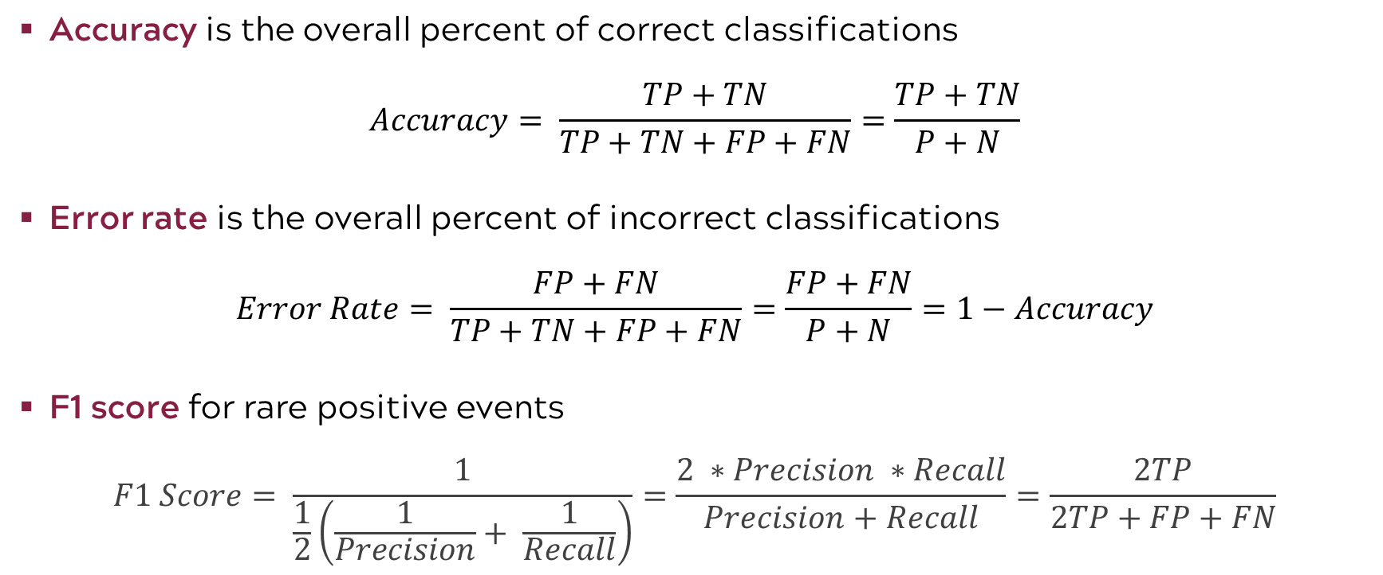
Some additional classification evaluation metrics
Accuracy is the overall percent of correct classifications
$$Accuracy= \frac{TP+TN}{TP+TN+FP+FN}=\frac{TP+TN}{P+N}$$
Error rate is the overall percent of incorrect classifications
$$Error Rate= \frac{FP+FN}{TP+TN+FP+FN}=\frac{FP+FN}{P+N}=1−Accuracy$$
F1 score for rare positive events
$$F1 Score= \frac{1}{\frac{1}{2}\left(\frac{1}{Precision}+ \frac{1}{Recall}\right)}=\frac{2 ∗Precision ∗Recall}{Precision+Recall}=\frac{2TP}{2TP+FP+FN}$$
Notes:
In the case of rare events or skewed data, the accuracy metric can be deceptive because you can get very high classification accuracies or very low errors – should not rely only on accuracy
For example, a dataset with 99% instances of one class and 1% of another is skewed
Accuracy doesn’t distinguish how well the model performs on the minority class as it doesn’t distinguish between false positives and false negatives
To evaluate models on imbalanced datasets more effectively, alternative metrics like precision, recall, F-score, and the area under the ROC curve are often preferred
F1 is based on the harmonic mean, often used for averaging rates, because it is more sensitive to small values. It gives a clearer picture of the overall performance in the case of rare events.
F1 helps balance precision and recall
The higher F1 score, the better

Slide 10
Code road map
1) Import Modules + Packages
2) Visualize Data
3) Build Training + Test Datasets
4) For each model:
Fit model with training data
Generate predicted labels
Evaluate performance
Notes:
Also recall our code rode map

Slide 11
Introduction to Machine Learning Course Roadmap
What is the goal of the data analysis?
Predict an output |  |  |  |  |  | Reveal patterns or relationships |  | Make decisions using an autonomous agent
Supervised Learning (Output in the data set) |  |  |  |  |  | Unsupervised Learning (No output in the data set) |  | Reinforcement Learning* (Supervised & unsupervised)
Continuous or discrete output? |  |  |  |  |  | What is the subgoal? |  | Does a model exist?
Continuous |  |  | Discrete |  |  | Identify groups | Reduce dimensions | Model Based | Model Free
Simple linear regression Multiple linear regression Subset selection Ridge regression & LASSO PCR & PLS | Polynomial regression Step functions Splines Local regression General additive models | Decision tree Random forest Neural network Gradient boosting tree | Logistic regression Linear discriminant analysis Quadratic discriminant analysis | Decision tree Random forest Neural network Gradient boosting tree | Support vector machines | Hierarchical clustering K-means clustering | Principal components analysis | Given the model Learn the model | Policy Optimization Q-Learning
Hierarchical clustering
K-means clustering
Principal components analysis
Neural network
Neural network
*Advanced Topic: Bonus module if time
Notes:
This course roadmap gives a nice overview of the machine learning algorithms we will cover in the following training modules. However, we want you to be aware of the ever-evolving landscape of machine learning. It is important to keep up to date on new algorithms. The modules supplied here will give you a great foundation for expanding that knowledge.

